Slide 1
Arabic to English Translation using Pretrained NLP Models
Project Summary, Code Highlights, and Future Ideas
Presented by: Marwan (Computer Science @ Helwan University)

Slide 2
Project Overview
Project Title:
Arabic to English Translation using Pretrained NLP Models
Goal:
Build an Arabic-to-English translation model with a user-friendly GUI using Hugging Face transformers and Gradio , Streamlite and tkintker
Core Task:
Sequence-to-sequence translation.
Model Used:
Helsinki-NLP/opus-mt-ar-en (MarianMTModel)

Slide 3
Dataset - Sources & Context
Initial Data Sources (from original notebook):
- Restof_AOC_merged_subtitles.xlsx
- merged_Articles.xlsx
- merged_subtitles_comments2.xlsx is Made from datasets : 1- https://www.kaggle.com/datasets/mostafanofal/two-million-rows-egyptian-datasets
2- https://www.kaggle.com/datasets/arhouati/arabic-news-articles-from-aljazeeranet?select=article_aljazeera.csv
3- https://www.kaggle.com/datasets/augustmurr/movie-parallel-dataset
Kaggle Collection Context:
Data likely related to '2.5+ Million Rows Egyptian Datasets Collection' (Kaggle).
This collection aimed to automate novel term detection in Egyptian Arabic.

Slide 4
Dataset - Preparation & Sampling
Steps:
Merged 3 Arabic-English parallel datasets.
Shuffled and sampled 100,000 rows for the project.
Removed null values and stripped extra whitespace.
Code Snippet (Pandas):
merged_df = pd.concat([df1, df2, df3], axis=0)
df = merged_df.drop(columns=["Unnamed: 0"]) # If exists
df = df.sample(frac=1).reset_index(drop=True).head(100000)
df.dropna(subset=["Text_Arabic", "Text_English"], inplace=True)

Slide 5
Dataset - Formatting for HuggingFace
Process:
Cleaned data converted to HuggingFace Dataset object.
Split into training (80%) and testing (20%) sets.
Code Snippet (Datasets library):
# Assuming 'dataset' is a HuggingFace Dataset object
dataset_split = dataset.train_test_split(test_size=0.2)
processed_dataset = DatasetDict({
"train": dataset_split["train"],
"test": dataset_split["test"]
})

Slide 6
Model & Tokenizer
Model: MarianMT (Transformer architecture)
MarianMTModel from Hugging Face transformers. )Sequence-to-sequence model(
Pre-trained Checkpoint:
Helsinki-NLP/opus-mt-ar-en
Model structure :
Arabic sentence -> encoder ->decoder->English sentence
Code Snippet
model_name = "Helsinki-NLP/opus-mt-ar-en"
tokenizer = MarianTokenizer.from_pretrained(model_name)
model = MarianMTModel.from_pretrained(model_name)

Slide 7
Component of model
Tokenizer | Converts the Arabic sentence into numbers (tokens) using a method called SentencePiece.
Embedding Layer | Transforms the tokens into vectors that the model can understand.
Encoder | A stack of Transformer layers (self-attention + feedforward) to understand the context in Arabic.
Decoder | Also Transformer layers, but it generates one English word at a time based on the previous output.
Output Layer | Produces probabilities for each English word and selects the most likely one.
Beam Search / Greedy Decoding | Techniques used to choose the best possible sentence during generation.

Slide 8
Preprocessing Function
Purpose:
Tokenize Arabic inputs and English targets.
Truncate sequences to max length (128 tokens).
Code Snippet:
tokenizer = AutoTokenizer.from_pretrained("Helsinki-NLP/opus-mt-ar-en")
def preprocess_function(examples):
inputs = examples["ar"] # Assuming 'ar' column
targets = examples["en"] # Assuming 'en' column
model_inputs = tokenizer(inputs, max_length=128, truncation=True)
with tokenizer.as_target_tokenizer():
labels = tokenizer(targets, max_length=128, truncation=True)
model_inputs["labels"] = labels["input_ids"]
return model_inputs
# tokenized_ds = processed_dataset.map(preprocess_function, batched=True)

Slide 9
Training Setup
Components:
Seq2SeqTrainingArguments: Configures training parameters.
Seq2SeqTrainer: Handles the training and evaluation loop.
DataCollatorForSeq2Seq: Batches and pads data.
Code Snippet (Training Arguments):
training_args = Seq2SeqTrainingArguments(
output_dir="./results(nlp)",
learning_rate=2e-5,
per_device_train_batch_size=8,
num_train_epochs=3,
logging_dir="./logs",
# ... other args like evaluation_strategy, save_strategy etc.
)
# trainer = Seq2SeqTrainer(...)
# trainer.train()

Slide 10
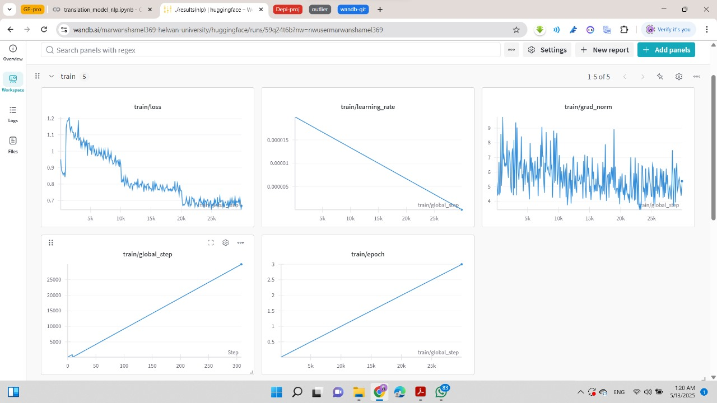
Evaluation (with w&b)

Slide 11
Model Parameters (Summary)
Pre-trained Checkpoint:
Helsinki-NLP/opus-mt-ar-en
Key Training Hyperparameters:
- Learning Rate: 2e-5
- Batch Size (train): 8
- Epochs: 3
Tokenizer Parameters:
- Max Length: 128
- Truncation: True

Slide 12
Evaluation with BLEU
Metric:
BLEU (Bilingual Evaluation Understudy) score.
Library Used:
`evaluate` library from Hugging Face (e.g., evaluate.load('bleu')).
Process:
1. Generate predictions from the model on the test set.
2. Decode predictions and reference (target) sentences.
3. Clean text (remove special tokens).
4. Compute BLEU score comparing predictions to references.

Slide 13
Evaluation Metrics (After Fine-Tuning on Arabic-English Translation)
Metric | Value | Notes
Eval Loss | 0.738 | Indicates good generalization.
BLEU Score | 0.5273 | High-quality translation (above 0.5 is excellent).
Brevity Penalty | 1.0 | Translation matches reference length.
Length Ratio | 1.009 | No over- or under-generation.
Translation Length | ~712K words | Large-scale evaluation.
Train Loss | 0.828 | Consistent with eval → No overfitting.

Slide 14
Model Saving & Inference
Saving the Fine-Tuned Model:
The model and tokenizer are saved after training.
Code Snippet (Saving):
trainer.save_model("fine_tuned_ar_en_model")
tokenizer.save_pretrained("fine_tuned_ar_en_model")
Inference Function (Translate):
Accepts Arabic text, returns English translation.
Code Snippet (Translate):
def translate(text):
inputs = tokenizer(text, return_tensors="pt").to(model.device)
translated_ids = model.generate(**inputs)
return tokenizer.decode(translated_ids[0], skip_special_tokens=True)

Slide 15
Gui interface
1- Gradio
2-streamlit
3-tkinter

Slide 16
GUI Deployment with Gradio
Purpose:
Provide a user-friendly interface for the translation model.
Tool Used:
Gradio library.
Process:
1. Load the fine-tuned model and tokenizer.
2. Define the translation function to be used by Gradio.
3. Create a Gradio Interface.
Code Snippet (Gradio Interface):
import gradio as gr
iface = gr.Interface(
fn=translate, # Your translation function
inputs=gr.Textbox(label="📝 أدخل نص عربي", placeholder="..."),
outputs=gr.Textbox(label="🔤 الترجمة الإنجليزية", interactive=False),
title="🔁 مترجم عربي - إنجليزي"
).launch(share=True) # share=True for public link on Colab

Slide 17
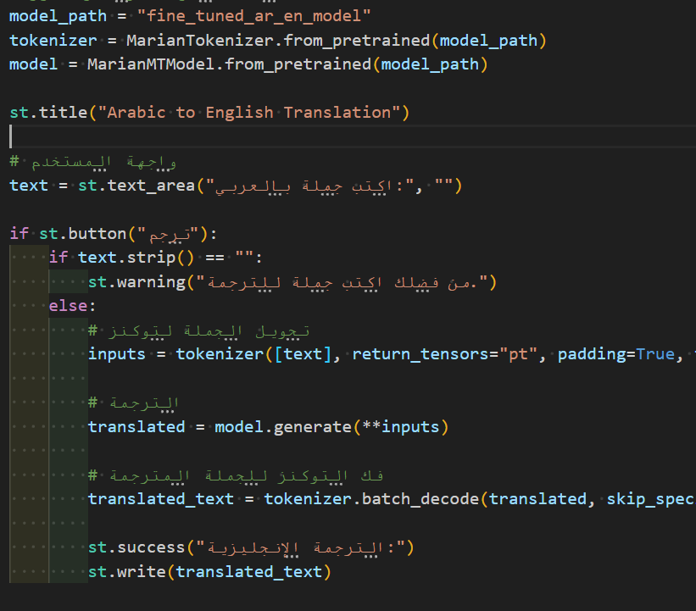
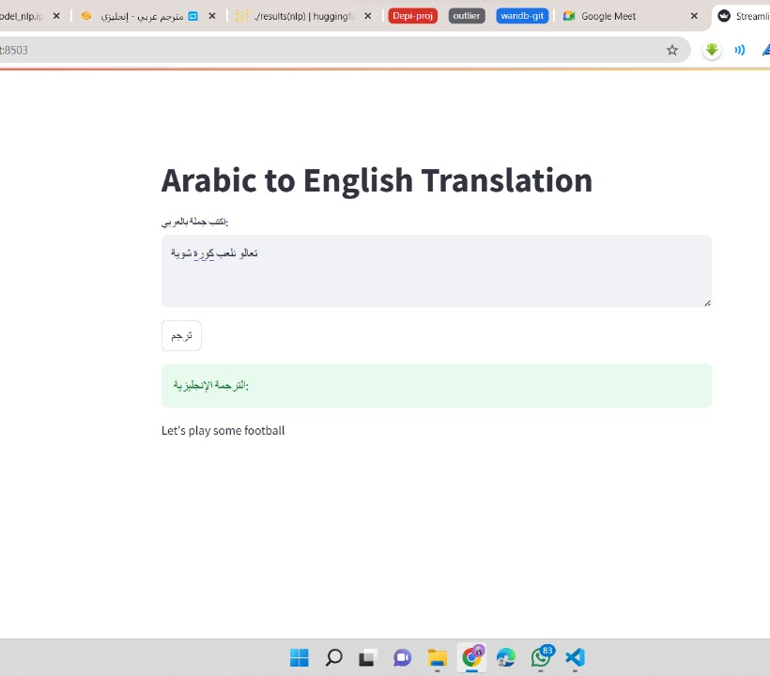
streamlit
Making app.py script that run code with command :
Stream run app.py

Slide 18
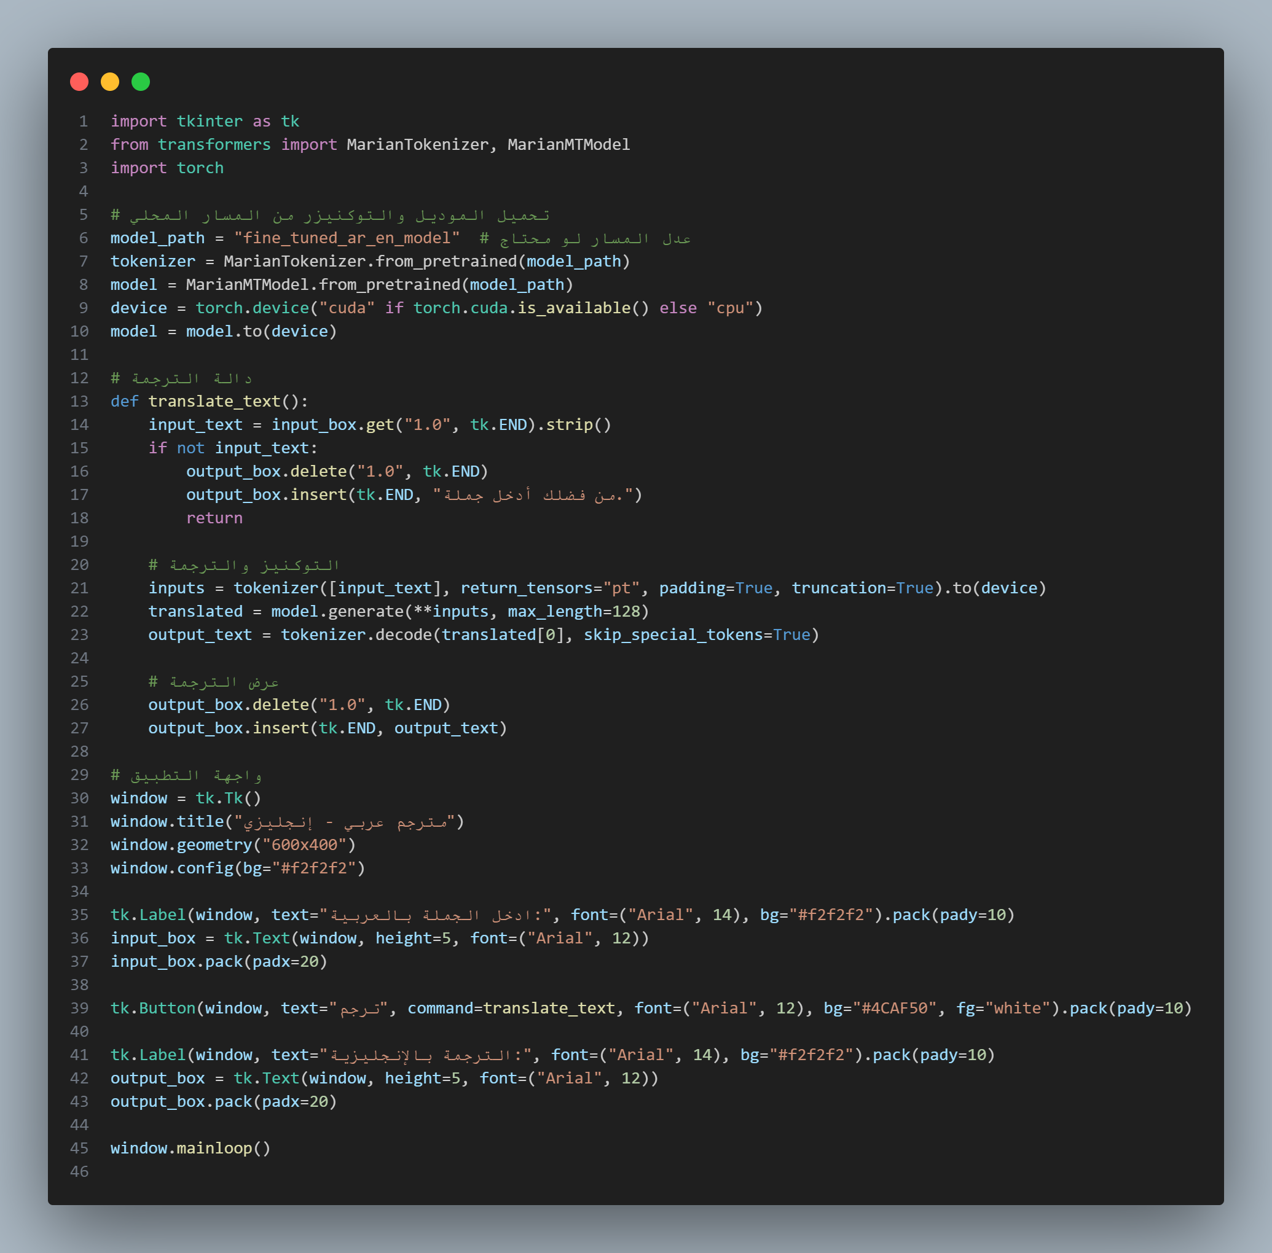
tkinter
It help to interact offline , and another option

Slide 19
Final Outcome & Limitations
Final Outcome:
A fully working Arabic-English translator.
Model evaluated using BLEU score.
Deployed with a user-friendly GUI (Gradio).
Ready for end-user testing and further deployment.
Model Limitations (General):
- Handling of specific dialects / nuanced text.
- Performance on out-of-domain data.
- Max sequence length, computational resources.

Slide 20
Further Project Ideas (User Suggested)
Building on Translation & Arabic NLP:
Arabic summarization for books and articles
Autocorrect for Arabic
Paraphrasing for Arabic
Question answering for Arabic
Arabic Named Entity Recognition (NER)
Arabic Autocomplete System
(Current project successfully implemented Arabic-English Translation with GUI)

Slide 21
Q&A and Thank You
Thank you for your attention!

